Slide 1

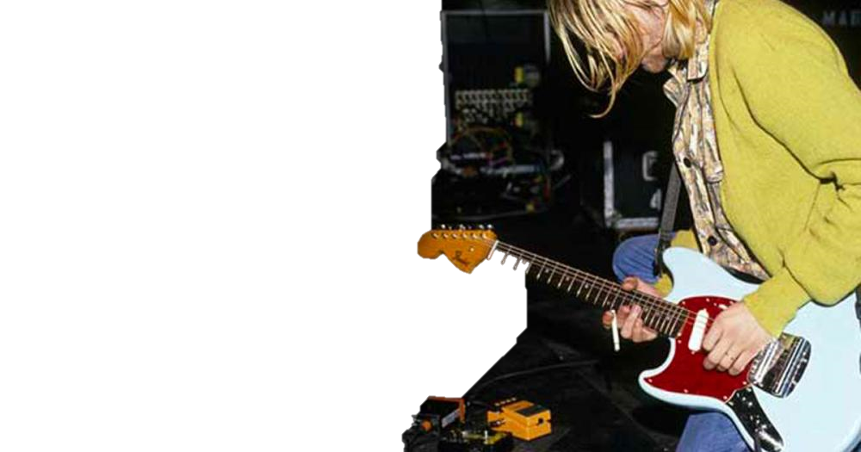
Johan
Rodriguez

Slide 2
Johan
About my life
Rodriguez
I want to spend my life in happy aspect because life is short enjoy it
I’m 18 years old
Living in Mariveles, Bataan
My hobby is to play guitar
My family
Were a little family that live in the peaceful place called 54
I have a 2 brothers and 1 sister and I am the youngest

